Slide 1
Predicting Airline Passenger Satisfaction Using Machine Learning: A Data-Driven Approach to Enhancing Customer Experience
By
Yushma Premchand

Slide 2
Problem Statement
In the competitive airline industry, understanding customer satisfaction is essential for improving service quality and retaining loyal passengers. This project aims to develop a machine learning model that predicts whether a customer is "Satisfied" or "Neutral/Unhappy" based on various factors including demographic details, travel characteristics, and service-related ratings such as booking ease, inflight service, cleanliness, entertainment, and more. By identifying the key drivers of satisfaction, airlines can take proactive steps to enhance passenger experiences, optimize operations, and make informed, data-driven decisions to improve overall customer engagement.
Business Goal:
Improve overall customer experience by identifying pain points.
Predict customer satisfaction to proactively address service gaps.
Segment customers based on their likelihood of satisfaction for targeted service improvements.

Slide 3
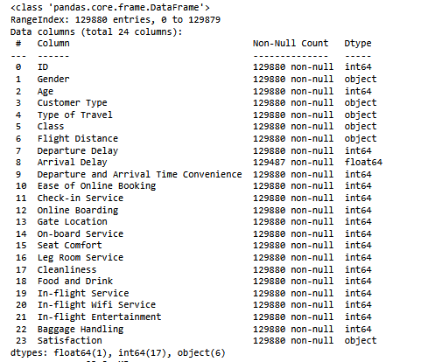
About the dataset

Slide 4
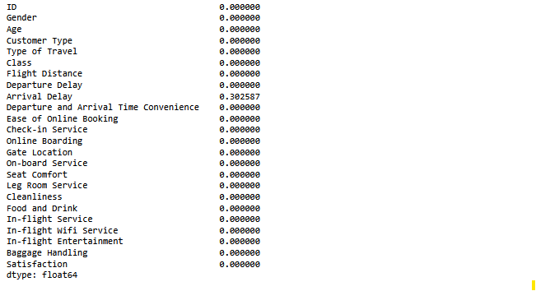
Missing Values

Slide 5

Imbalance Data

Slide 6
Column Encoding
One hot encoding done for Class column.
Encoding done on Gender, Customer Type, Type of Travel, Satisfaction, Class_Economy, Class_Economy plus .
All object columns converted as Numerical columns.
Dropped duplicate rows and ID column.

Slide 7
Logistic regression
Decision Tree regression
Training Accuracy – 0.80067754
Test Accuracy – 0.80366492
With Cross Validation- 0.8044348623
Training Accuracy – 1.0
Test Accuracy – 0.937162508
With Cross Validation- 0.93634124

Slide 8
Bagging Classifier
Random Forest Classifier
Training Accuracy – 0.99544194
Test Accuracy – 0.952058310
With Cross Validation-0.95205831
Training Accuracy – 0.94789036
Test Accuracy –0.940724771
With Cross Validation- 0.94108407

Slide 9
XGBoost Classifier
SVM
Training Accuracy – 0.98654142
Test Accuracy – 0.95943948
With Cross Validation-0.95796119
Training Accuracy – 0.61352017
Test Accuracy –0.617780513
With Cross Validation- 0.59855251

Slide 10
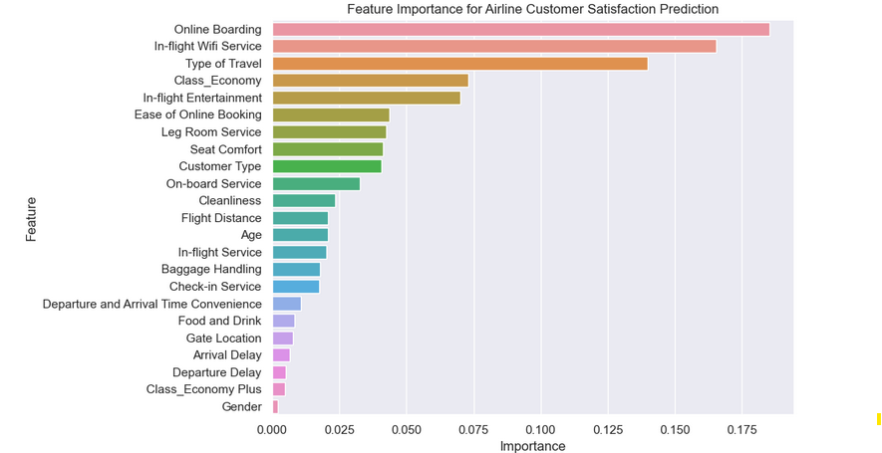
Feature Importance

Slide 11
Online Boarding – Most critical factor; likely due to convenience and speed.
In-flight Wi-Fi Service – Connectivity is increasingly valued.
Type of Travel – Business vs. personal travel impacts satisfaction expectations.
Class_Economy – Travel class significantly affects comfort and service level.
In-flight Entertainment – Keeps passengers engaged and comfortable.

Slide 12
Targeted Service improvements
Calculated the probabilities of the satisfied customer
Segregated according to segments
Targeted high, medium and Low risk customers

Slide 13

Segment wise Action Plan

Slide 14
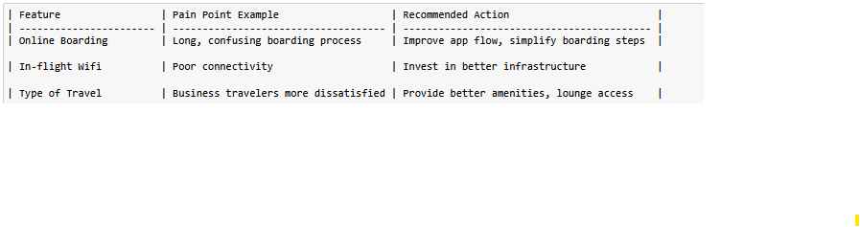
Recommend Improvements Based on Findings

Slide 15
THANK YOU

